Slide 1
DeFi Bank (Decentralized Finance)
INTRODUCTION BLOCKCHAIN AND CRYPTO CURRENCIES
2010030370 – Varshith
2010030173 – Harsha Vardhan
2010030416 – Dileep
Guided by - Dr. P Lalitha Surya Kumari

Slide 2
ABSTRACT --
Decentralized finance (DeFi) is an emerging financial technology based on secure distributed ledgers similar to those used by cryptocurrencies. The system removes the control banks and institutions have on money, financial products, and financial services.
It eliminates the fees that banks and other financial companies charge for using their services
You can transfer funds in seconds and minutes

Slide 3
INTRODUCTION --
DeFi” – is an emerging open and global alternative to the restrictive, centralized and centuries-old traditional financial system much of the world knows today. DeFi offers anyone with a smartphone and an internet connection the opportunity to put their money to work on their terms across services like investing, borrowing, lending, and trading

Slide 4
LITERATURE REVIEW --
TITTLE | AUTHOR | PUBLISHED YEAR | SUMMARY
DECENTRALIZED FINANCE | Prof. Dr. Isabell Welpe, Prof. Dr. Philipp Sandner | 2022 ongoing | This paper says all about the research and backround of defi and different methodology
AI in DeFi | Nafiz Sadman, Abdur Rahman | 2022 | This paper will be saying about how can AI can be implemented in crypto and defi and intro to AI IN DEFI and blockchain
Lessons Learned from Defi | X. Meegan, T. Koens | 2017 | In this paper there will be about mistakes and how it will work in real world ,with different applications
DeFi Beyond the Hype | e Wharton Blockchain, Digital Asset Project | 2021 | It describes the basic attributes of DeFi services, the structure of the DeFi ecosystem, and emerging developments. A forthcoming Decentralized Finance Policy-Maker Toolkit will offer guidance on risks and policy approaches for governments navigating this new space

Slide 5

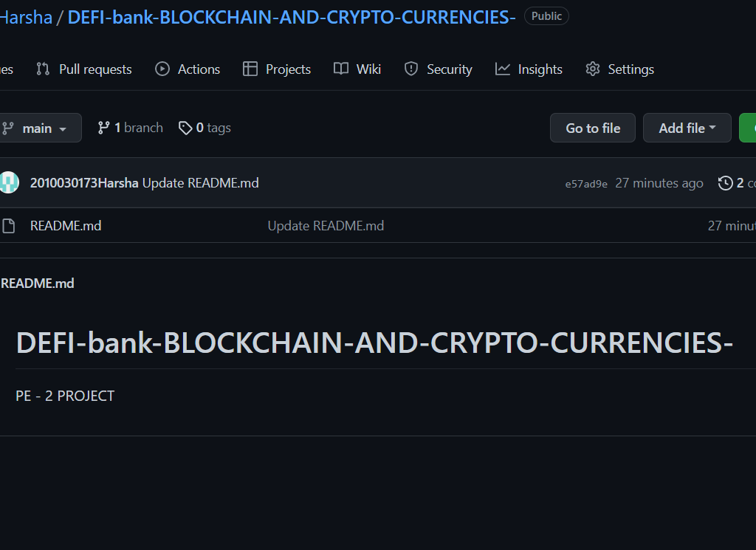
GITHUB LINK --
https://github.com/2010030173Harsha/DEFI-bank-BLOCKCHAIN-AND-CRYPTO-CURRENCIES-

Slide 6
TOOLS SETUP -
Language – solidity
Ide – Remix
Requirement – Internet

Slide 7
WORK ALLOCATION
Harsha Vardhan – selected project and collected datasets and info
Varshith – collected references and collected information
Dileep – collected information and created ppt

Slide 8
CONCLUSION--
The conclusion ,this is one of emerging project and very useful to people and should be used by everyone and change the things around us

Slide 9
REFERENCES --
https://www.finimize.com/wp/guides/introduction-to-decentralized-finance-defi/
https://www.ingwb.com/binaries/content/assets/insights/themes/distributed-ledger-technology/defi_white_paper_v2.0.pdf
https://wifpr.wharton.upenn.edu/wp-content/uploads/2021/05/DeFi-Beyond-the-Hype.pdf

Slide 10
THANK YOU

